Slide 1

STIFFNESS MATRIX CALCULATION OF KUKA KR5 ROBOT
YASH DEV TIWARI (BTECH/10049/21)
AYUSH TIWARI (BTECH/10613/21)
SHRUTI JAIN (BTECH/10481/21)
Supervised by: Dr. Nirmal Kumar
Department of Mechanical Engineering , Birla Institute of Technology,
Mesra Ranchi - 835215

Slide 2
CONTENTS
S.NO. | TOPICS | SLIDE NO.
1. | INTRODUCTION | 3
2. | OBJECTIVE | 6
3. | LITERATURE REVIEW | 7
4. | RESEARCH GAPS | 8
5. | METHODOLOGY | 9
6. | RESULT | 13
7. | CONCLUSION | 15

Slide 3
Introduction to the Problem
Source: https://kuka.com/images
Operational Dilemma:
High speed sacrifices positional accuracy.
High accuracy reduces speed and efficiency.
Balancing speed and precision is crucial for industrial applications.

Slide 4
Stiffness & Mobility
Stiffness | Mobility
With high stiffness, cutting of hard materials can be achieved. | With high mobility, cutting of soft materials can be achieved with precision.
High stiffness generates higher torques and forces. | Mobility generates lower torques and forces.
There is low precision | There is higher precision.

Slide 5
Research Objective
Primary Objectives:
Calculating the stiffness matrix of the Kuka KR5 robot.
Analyze stiffness variations and identify optimal configurations.

Slide 6
Literature Review
Literature | Insights
Dumas, C., Caro, S., Cherif, M., Garnier, S. and Furet, B., 2012. Joint stiffness identification of industrial serial robots. Robotica, 30(4), pp.649-659. | Followed the methodology of calculating the stiffness matrix.
Khalil, W. and Dombre, E., 2004. Modeling, identification and control of robots. Butterworth-Heinemann. | Calculation of D-H Parameters
Golub, G.H. and Van Loan, C.F., 2013. Matrix computations. JHU press | Transformation matrices.
Renders, J.M., Rossignol, E., Becquet, M. and Hanus, R., 1991. Kinematic calibration and geometrical parameter identification for robots. IEEE Transactions on robotics and automation, 7(6), pp.721-732. | Calculation of Jacobian Matrix

Slide 7
Research Gaps
Specific Gaps
Limited focus on Kuka KR5 stiffness behavior.
Lack of insights into stiffness-speed-accuracy trade-offs.
Opportunity: Targeted research on stiffness profiles for enhanced robotic performance.

Slide 8
METHODOLOGY (Kinematic Modeling)
Steps Involved:
Define D-H parameters.
Calculate transformation matrices for each joint.
Derive Jacobian vectors for stiffness calculations.

Slide 9
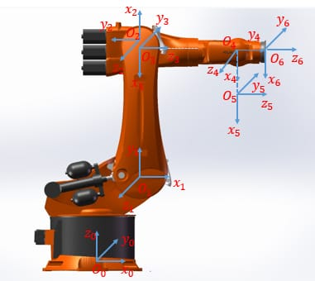
METHODOLOGY
Developed a kinematic model using D-H parameters.
Source: https://images.app.goo.gl/fi6Gu5atmMnjHmif6

Slide 10
Methodology
Calculated the Transformation matrix
T01 = dhtransform[θ1 , 0.4, 0.18, Pi/2]
T12 = dhtransform[θ2 , 0.135, 0.6, Pi]
T23 = dhtransform[θ3 , 0.135, 0.12, -Pi/2]
T34 = dhtransform[θ4 , 0.62, 0, Pi/2]
T45 = dhtransform[θ5 , 0, 0, -Pi/2]
T56 = dhtransform[θ6 , 0.115, 0, 0]
Overall transformation matrix
TT= T01.T12.T23.T34.T45.T56

Slide 11
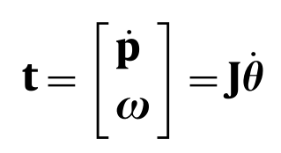
Methodology
Calculated the Jacobian vector
‘t’ is its end-effector twist, which is composed of its translational velocity vector ‘p’ and its angular velocity vector ‘w’.

Slide 12
Methodology
Calculated the Stiffness matrix:
Kθ=DiagonalMatrix[{kθ1,kθ2,kθ3,kθ4,kθ5,kθ6}];
Kx=Transpose[Jn].Kθ.Jn;
Where, Kθ = Joint stiffness matrix
Kx = Stiffness Matrix

Slide 13
Results
Stiffness Matrix:
Derived from experimental data at various configurations.
High stiffness observed in configurations maximizing mechanical advantage.

Slide 14
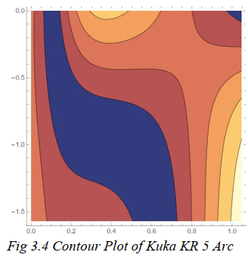
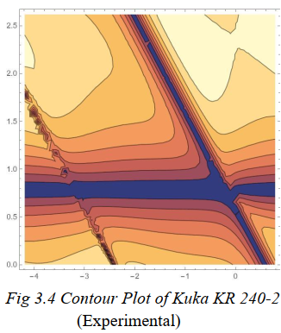
Results(Key findings)
Regions of high stiffness (yellow/orange) allow better accuracy at higher speeds.
Low-stiffness regions (blue/purple) identified as potential risk areas for inaccuracies.

Slide 15
Actual experimental process (future scope)
Measuring the Force/Torque in end-effector of the robotic manipulator.
This will be achieved with the help of a Force/Torque sensor.
Connecting the Force/Torque sensor with the transducer of KUKA KR-5 robot.

Slide 16
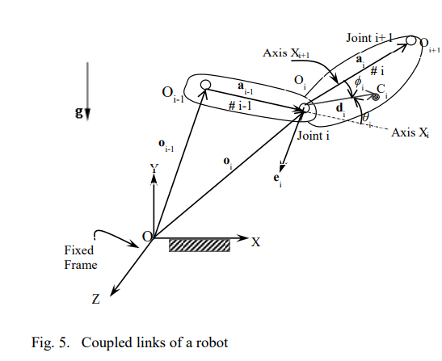
Methodology
Source - https://www.academia.edu/download/77370348/105-inacomm2013_submission_202.pdf

Slide 17
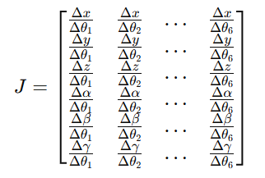

Calculations
Torque for each arm is written as:
$\begin{matrix}{\text{τ}}_{x} \\ τ_{y}\end{matrix}$ = ${\{J\}}^{T}$ . $\begin{matrix}F_{x} \\ F_{y}\end{matrix}$
Whereas, Jacobian for each arm will be written as:

Slide 18
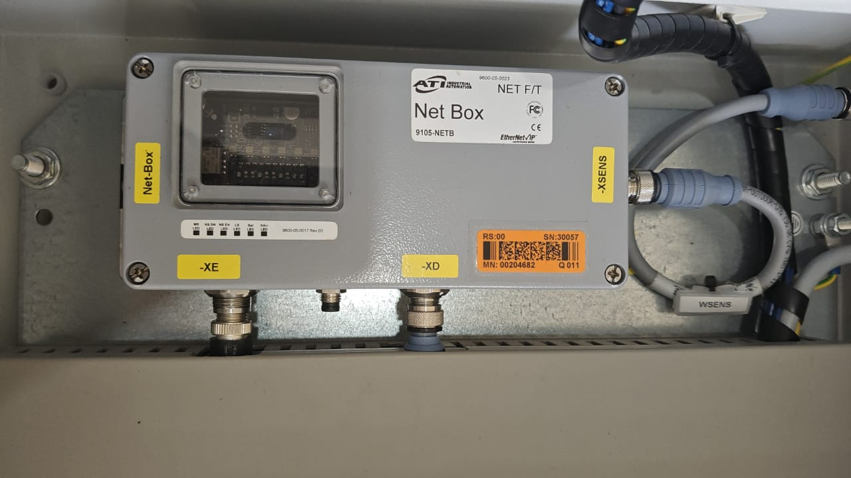
Procedure
Setting up the Net Box.
Source – Robotics lab BIT Mesra.

Slide 19
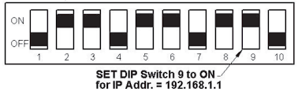
Toggling the 9th DIP (Duel In-Line Package) switch.
Why? – To get a specified IP address so that the results can be displayed on the browser of a computer.

Slide 20
Connecting the equipment
Next step involves setting up the computer system.
OS – Windows XP, Windows 7
Software – ATI FT Data Viewer
This action will be completed by connecting the computer to the net box with the help of a Ethernet cable.

Slide 21
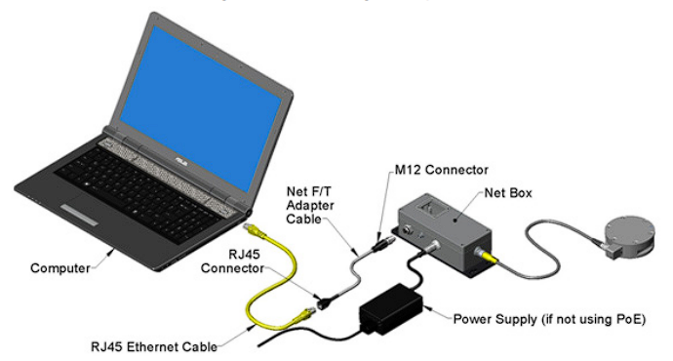
Connecting the equipment
Source - https://www.ati-ia.com/app_content/documents/9610-05-1022%20Quick%20Start.pdf

Slide 22
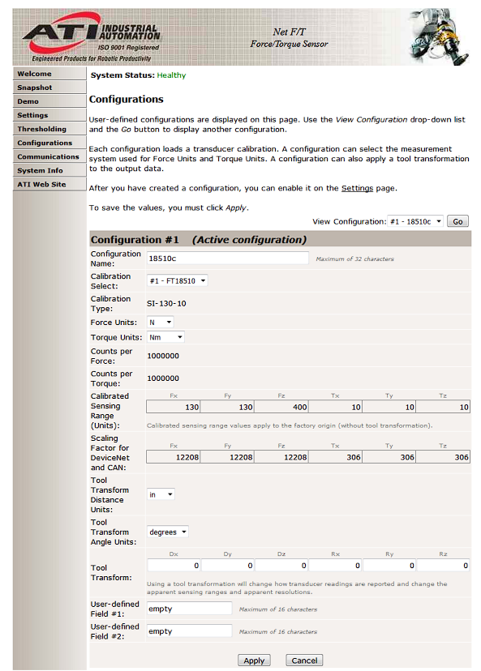
Connecting the equipment (UI of Force/Torque readings)

Slide 23
Conclusion
The transformation matrix is calculated.
The accuracy of the transformation matrix is checked experimentally.
Using the transformation matrix and Jacobian vectors, the stiffness matrix is calculated.
Future Scope:
The stiffness matrix will be checked experimentally.

Slide 24
References
Dumas, C., Caro, S., Cherif, M., Garnier, S. and Furet, B., 2012. Joint stiffness identification of industrial serial robots. Robotica, 30(4), pp.649-659.
Khalil, W. and Dombre, E., 2004. Modeling, identification and control of robots. Butterworth-Heinemann.
Golub, G.H. and Van Loan, C.F., 2013. Matrix computations. JHU press.
Renders, J.M., Rossignol, E., Becquet, M. and Hanus, R., 1991. Kinematic calibration and geometrical parameter identification for robots. IEEE Transactions on robotics and automation, 7(6), pp.721-732.
Nagata F, Hase T, Haga Z, Omota M, Watanabe K. CAD/CAM-based position.
Force controller for a mold polishing robot. Mechatronics 2007;17:207–16.
Angeles J, Caro S, Khan W, Morozov A. The design and prototyping of an innovative Schonflies motion generator. Proceedings of the IMechE Part C, Journal of Mechanical Engineering Science, special issue: Kinematics Kinmatic Geometry and their applications 2006;220(7):935–44.
Li Z. Geometrical consideration of robot kinematics. The International Journal of Robotics and Automation 1990;5(3):139–45
Chen S-F, Kao I. Conservative congruence transformation for joint and Cartesian stiffness matrices of robotics hands and fingers. The International Journal of robotics Research 2000;19:835
Alici G, Shirinzadeh B. Enhanced stiffness modeling, identification and characterization for robot manipulators. IEEE Transactions on Robotics 2005;21(4):554–64

